Slide 1
MESSAGE DRIVEN BEAN
CHANDEESH (20MX107)
RUBA PRIYA DHARSHINI K (20MX119)
HARIHARAN B (20MX207)
SHERWIN RICHARD (20MX218)
SRI GURU PRASATH M (20MX220)

Slide 2
MEAASAGE DRIVEN BEAN
A message-driven bean is an enterprise bean that allows Java EE applications to process messages asynchronously.

Slide 3
DIFFERENCE BETWEEN MESSAGE DRIVEN BEAN AND SESSION BEAN
The most visible difference between message-driven beans and session beans is that clients do not access message-driven beans through interfaces. Interfaces are described in the section Accessing Enterprise Beans. Unlike a session bean, a message-driven bean has only a bean class.

Slide 4
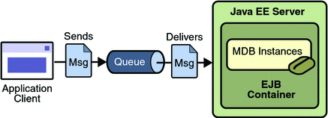
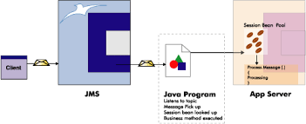
MESSSAGE DRIVEN BEAN

Slide 5
WHEN TO USE A MESSAGE DRIVEN BEAN
To receive messages asynchronously, use a message-driven bean.

Slide 6
Life Cycle of Message Driven Bean
Just as the entity and session beans have well-defined life cycles, so does the MDB bean.
The MDB instance’s life cycle has two states:
Does Not Exist
Method-Ready Pool .
The Method-Ready Pool is similar to the instance pool used for stateless session beans.

Slide 7
Life Cycle
Does Not Exist
Class.newinstance()
setMessageDrivenContext()
ejbCreate()
ejbRemove()
Method Ready Pool
onMessage()

Slide 8
Does Not Exist
When an MDB instance is in the Does Not Exist state, it is not an instance in the memory of the system.
It has not been instantiated yet.
The Method-Ready Pool
MDB instances enter the Method-Ready Pool as the container needs them.
When the EJB server is first started, it may create a number of MDB instances and enter them into the Method-Ready Pool
When the number of MDB instances handling incoming messages is insufficient, more can be created and added to the pool.

Slide 9
Transitioning to the Method-Ready Pool
When an instance transitions from the Does Not Exist state to the Method-Ready Pool, three operations are performed on it.
First, the bean instance is instantiated when the container invokes the Class.newInstance( ) method on the MDB class.
Second, the setMessageDrivenContext( ) method is invoked by the container providing the MDB instance with a reference to its EJBContext.
Finally, the no-argument ejbCreate( ) method is invoked by the container on the bean instance. The MDB has only one ejbCreate( ) method, which takes no arguments. The ejbCreate( ) method is invoked only once in the life cycle of the MDB.
MDBs are not subject to activation, so they can maintain open connections to resources for their entire life cycles. The ejbRemove( ) method should close any open resources before the MDB is evicted from memory at the end of its life cycle.

Slide 10
Life in the Method-Ready Pool
Once an instance is in the Method-Ready Pool, it is ready to handle incoming messages. When a message is delivered to an MDB, it is delegated to any available instance in the Method-Ready Pool.
While the instance is executing the request, it is unavailable to process other messages.
The MDB can handle many messages simultaneously, delegating the responsibility of handling each message to a different MDB instance.
When a message is delegated to an instance by the container, the MDB instance’s MessageDrivenContext changes to reflect the new transaction context. Once the instance has finished, it is immediately available to handle a new message.

Slide 11
Transitioning Out of the Method-Ready Pool: The Death of an MDB Instance
Bean instances leave the Method-Ready Pool for the Does Not Exist state when the server no longer needs them.
This occurs when the server decides to reduce the total size of the Method-Ready Pool by evicting one or more instances from memory.
The process begins by invoking the ejbRemove( ) method on the instance. At this time, the bean instance should perform any necessary cleanup operations, such as closing open resources.
The ejbRemove( ) method is invoked only once in the life cycle of an MDB instance—when it is about to transition to the Does Not Exist state.
During the ejbRemove( ) method, the MessageDrivenContext and access to the JNDI ENC are still available to the bean instance.
Following the execution of the ejbRemove( ) method, the bean is dereferenced and eventually garbage collected.

Slide 12
JMS API
The Java Message Service is a Java API that allows applications to create, send, receive, and read messages.
Designed by Sun and several partner companies, the JMS API defines a common set of interfaces and associated semantics that allow programs written in the Java programming language to communicate with other messaging implementations.

Slide 13
JMS API
The JMS API enables communication that is not only loosely coupled but also:
(I) Asynchronous
(II) Reliable

Slide 14
WHEN TO USE JMS API
An enterprise application provider is likely to choose a messaging API over a tightly coupled API, such as a remote procedure call (RPC)

Slide 15
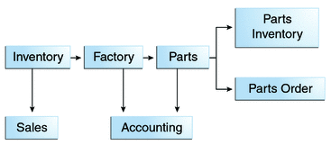
Manufacturing is only one example of how an enterprise can use the JMS API. Retail applications, financial services applications, health services applications, and many others can make use of messaging.

Slide 16
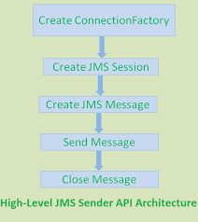
JMS API SENDER ARCHITECHURE

Slide 17
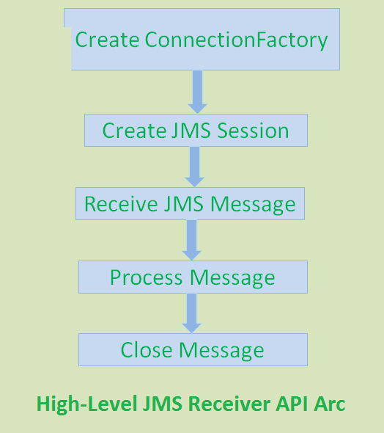
JMS API RECEIVER ARCHITECHURE

Slide 18
JAVA API
JAVA API
NEED FOR JAVA API
TYPES OF API
ADVANTAGES OF API

Slide 19
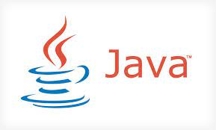
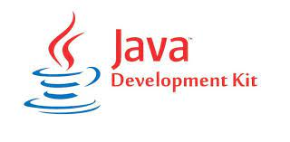

WHAT IS JAVA?

Slide 20
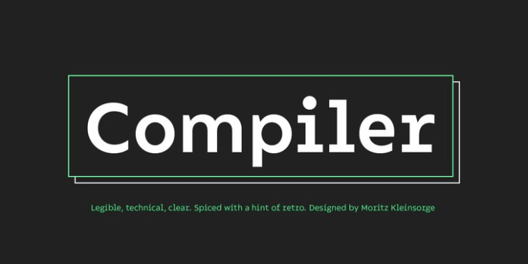
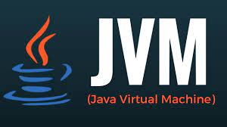
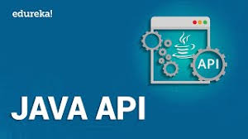
JDK

Slide 21
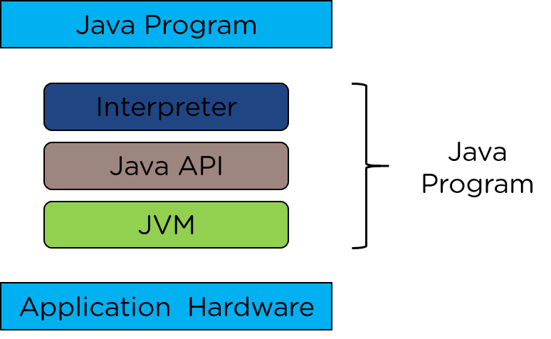
JAVA API

Slide 22
NEED FOR JAVA API
Streamline Operating Procedures
Improve Business Techniques
Create Powerful Applications

Slide 23
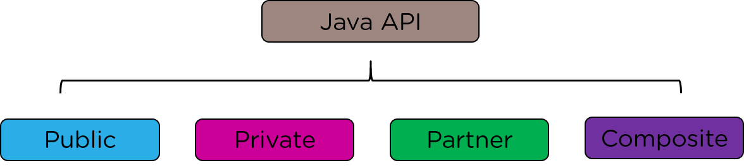
TYPES OF API

Slide 24
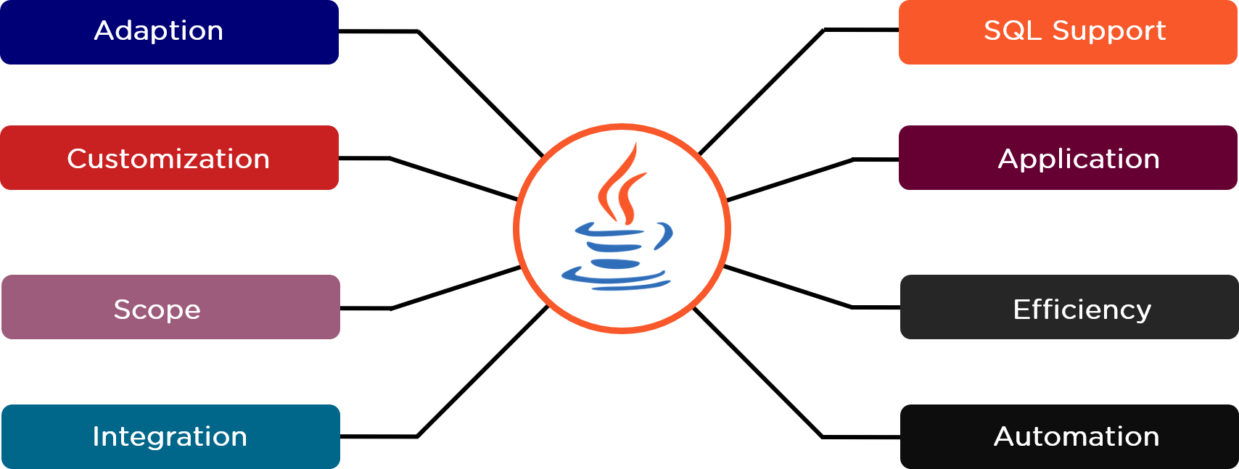
ADVANTAGES OF JAVA API

Slide 25
DEMONSTRATION

